Slide 1
Body Harmony Physical Therapy, PLLC
233 Broadway, Suite 1410
NY, NY 10279
T: 212 233 9494
www.bodyharmonypt.com
Pain with Sex: Men
Healing Through Awareness
Written by: Serenity Serafini, PT, DPT and Keely Faridi, PT, DPT
Edited by: Alyssa Hariprashad, PT, DPT and Nazneen Vasi, PT, DPT
1
Notes:
Fixing the logos

Slide 2
Body Harmony Physical Therapy
Experts in Pelvic Health Physical Therapy and Wellness
We are a boutique physical therapy clinic in Downtown Manhattan specializing in the evaluation and treatment of pelvic pain and dysfunction in women and men.
@Body Harmony Physical Therapy
@bodyharmonypt
@bodyharmonypt
@Body Harmony Physical Therapy, PLLC
© Body Harmony Physical Therapy, PLLC (2021 )- All Rights Reserved
2

Slide 3
Contents
Why Does Sex Hurt?
Healing Begins with Self Care
Connect to Your Breath
Exercises for Pelvic Pain
Positions to Ease Pelvic Pain
A Little Help in the Bedroom
The Role of Nutrition
Physical Therapy for My What?!
Resources
This e-book was created for informational purposes only and is not intended be a substitute for professional medical advice, diagnosis, or treatment. Always seek the advice of your physician or other qualified health provider with any questions you may have regarding a health condition.
© Body Harmony Physical Therapy, PLLC (2021) - All Rights Reserved
3

Slide 4
Chapter 01
Why Does Sex Hurt?
© Body Harmony Physical Therapy, PLLC (2021) - All Rights Reserved
4

Slide 5
Pain with Sex
Sex should never be painful, but for many people it is. Dyspareunia, or painful intercourse, can occur for a multitude of reasons. It could be a sign of a urologic condition such as bacterial prostatitis, or urinary tract infection. Thus, it is important to consult your urologist to rule out urological pathology.
Pain with sex may also have musculoskeletal components or origins secondary to muscle imbalances, excessive muscular tone, nerve compression or tension, fascia adhesions and restrictions, and/or decreased blood/lymphatic flow.
Pain with sex can present in many ways including muscle spasms, burning sensations, stinging, aching, throbbing and in many different areas:
Penis head
Penis shaft
Testicles
Pelvic floor muscles
Perineum
Rectum/anus
Tailbone
Bladder
Lower back
Lower abdomen
Hips and/or upper thighs
Superficial pain may be experienced with light touch to the external genitalia or upon vaginal entry, or it may only be with deep penetration and thrusting.
It is important to note that one can have pelvic pain for a number of years or it could be a something that only just started.
In whatever way your pain presents, know that this is not how your body should normally respond to sex and there are things that you can do to take control over your sexual experience including managing or even completely eliminate your pain. You deserve to have pain-free, pleasurable sex and Body Harmony Physical Therapy is here to help!
© Body Harmony Physical Therapy, PLLC (2021) All Rights Reserved
5
Notes:
For men, sexual dysfunction may include pain during and after ejaculation or with intercourse in general. The inability to obtain or maintain an erection may also occur. There are multiple factors that influence pain including physical, psychological/emotional factors and relationship/social factors that can affect sexual appreciation. Infection of the bladder, prostate or sexual organs can cause pain, intense itching or burning post ejaculation. Interstitial cystitis (also know as painful bladder syndrome) may experience pain at the moment of ejaculation.

Slide 6
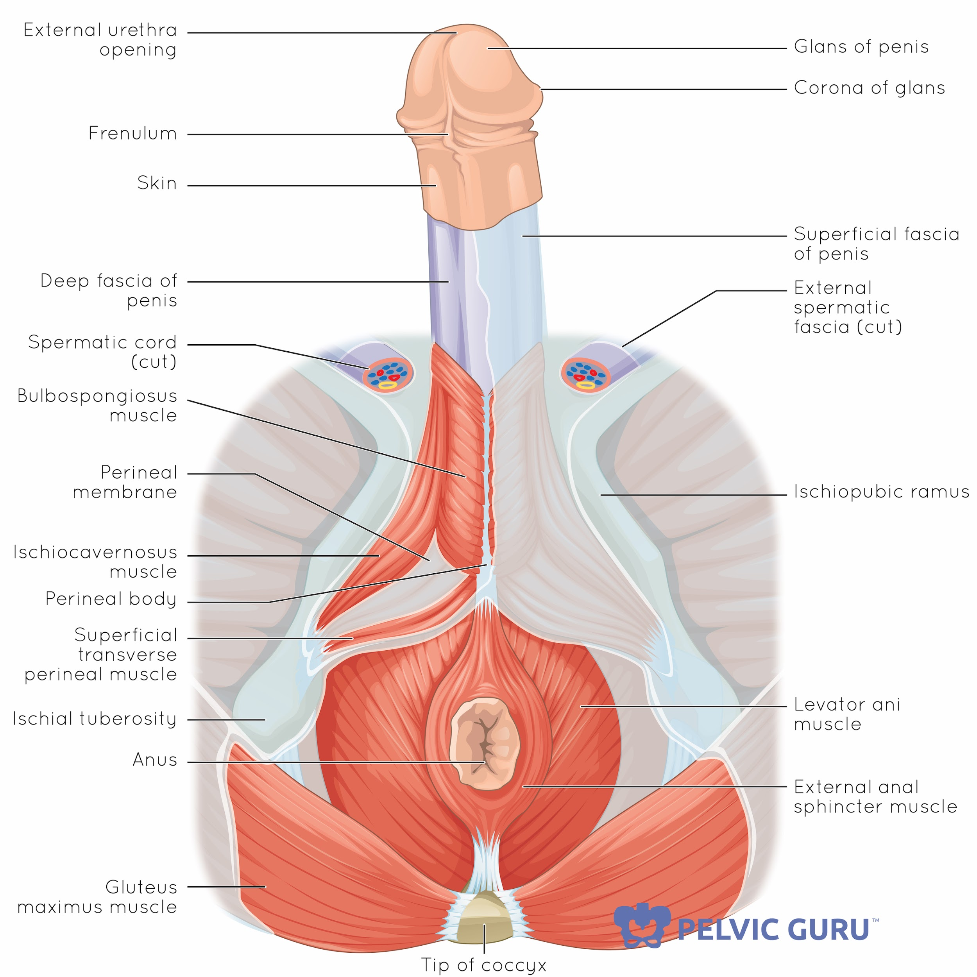
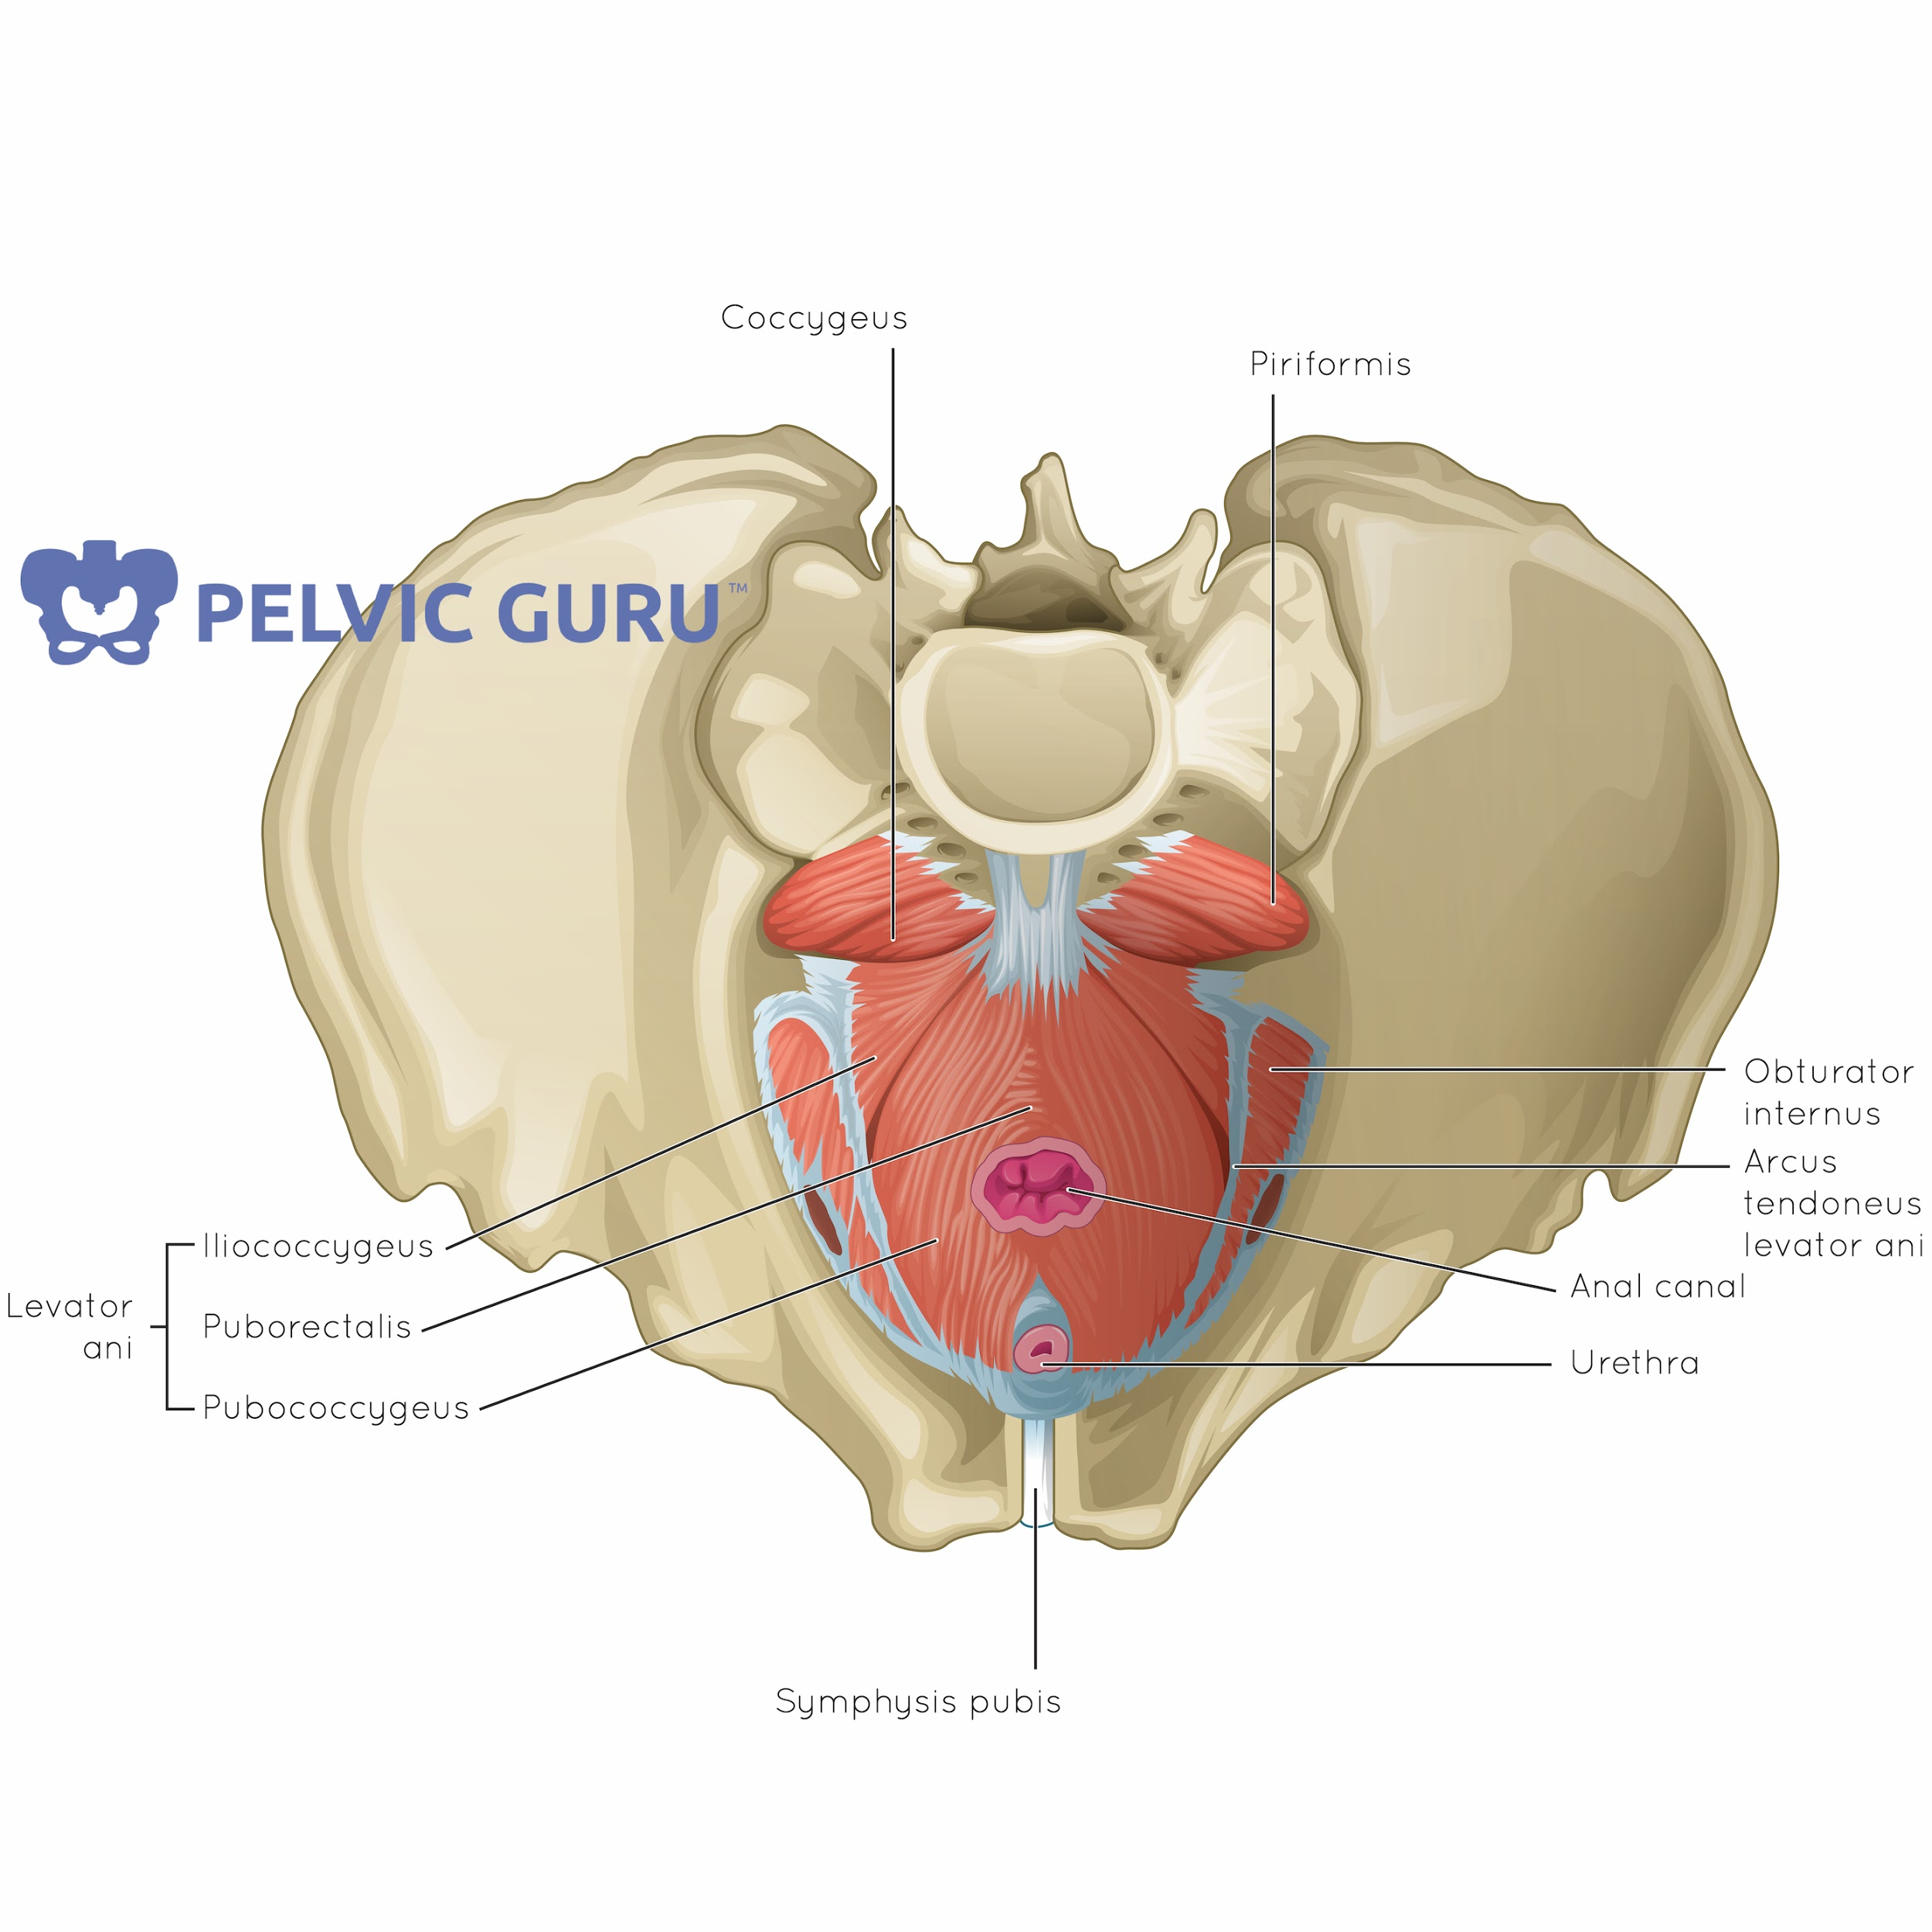
Get to Know Your Anatomy
Permission to use copyright images from Pelvic Guru, LLC
© Body Harmony Physical Therapy, PLLC (2021) - All Rights Reserved
6

Slide 7
CHAPTER 02
Healing Begins with Self Care
© Body Harmony Physical Therapy, PLLC (2021) - All Rights Reserved
7

Slide 8
Stress: It’s not just a feeling
Stress plays a huge role in our physical health and overall well-being. Understanding your body and how your daily habits can influence its processes can be a helpful tool in gaining control over your pain.
Our autonomic nervous system- the system responsible for regulating and maintaining the function our bodily processes automatically without our conscious control- has two components:
The sympathetic nervous system: our “fight or flight” response that prepares us to operate in emergency or dangerous situations. It is responsible for physiological changes such as elevating our heart and respiratory rates, releasing stored energy, and shifting more blood towards our skeletal muscles, which are needed to protect/defend ourselves from external threats. It also slows down systems that aren’t as important during those times, such as digestion and urination. (If a lion is chasing you, you don’t want to stop to pee!)
The parasympathetic nervous system: our “rest and digest” response controls our ordinary bodily functions. It is responsible for regulating physiological functions that allow our bodies to rest and restore energy, repair and heal, as well as build our immunity. It stimulates our digestive organs to breakdown food in order to absorb nutrients and eliminate waste. It also decreases our heart and respiratory rates during periods of rest to reduce excessive energy expenditure.
Of course, both of these components are necessary throughout our lifetime and allow us the flexibility to adapt to our surroundings and current situations. However, issues arise when we lack the appropriate balance between these systems and lose our ability to flexibly shift back and forth between these systems when necessary.
Maintaining a state of chronic stress due to work, family, finances, whatever your situation may be, can lead to more frequent sympathetic nervous system activation during times where our body doesn’t need to respond to a external threat. This leads to excessive physical stress on our body as there is less energy going towards rest, restoration, and healing.
© Body Harmony Physical Therapy, PLLC (2021) - All Rights Reserved
8

Slide 9
Relaxation Techniques
So, how does stress and our autonomic nervous system tie into pain with sex? Individuals with pelvic pain tend to have elevated tone or tension of their muscles at rest and often experience increased difficulty with relaxing their pelvic floor muscles. They are also likely to report higher levels of anxiety and stress, lack efficient coping strategies, and demonstrate strong physiological responses to physical and emotional stress. Thus, it is key to learn and implement strategies to manage stress and physiologically quiet our nervous system to allow for relaxation to occur, when we want it to occur.
Here are a few relaxation techniques to try:
Relaxed deep breathing: In any comfortable position, start to take deep, intentional breaths, allowing the rib cage to expand in all directions like a balloon filling up with air. Breathe in for 4 seconds, and out for 6-8 seconds. This lengthened exhale helps to down regulate your sympathetic nervous and tap into your parasympathetic nervous system to promote relaxation. Repeat for at least 5 breaths. You can do this with eyes open or eyes closed.
Meditation/Imagery: In any comfortable position, close your eyes and take deep, calm breaths. If you want, combine this technique with the breathing described above. Begin to envision a time, place, or event that makes you feel safe, peaceful, and content. It could be a forest, a hammock on the beach, your grandmother’s kitchen, in the arms of your partner, whatever feels best to you. Now visualize with all of your senses: what do see, hear, smell, feel, taste?
Hand warming: Imagine one of the following scenarios - you are holding a warm mug of tea, or holding your hands over the gentle warmth of a campfire, or curling your fingers into soft, warm sand. Now envision the warmest color you can think of slowly glowing brighter around your hands and wrists and say or think to yourself “My fingers are getting warmer; my palms are getting warmer; my wrists are getting warmer.” This technique helps to reset your autonomic nervous system and promote feelings of calm and wellbeing by improving blood pressure, circulation, and pain response. Practice this for at least 30-60 seconds at a time.
© Body Harmony Physical Therapy, PLLC (2021) - All Rights Reserved
9

Slide 10
Relaxation Techniques
Mindfulness: Mindfulness is the conscious practice of being fully present in the moment and allowing ourselves to become aware of where we are, what we’re doing, what’s happening within our bodies, and not become overwhelmed by what’s happening around us. Body scanning is a helpful technique that allows us to practice mindfulness within the context of body awareness and encourages relaxation in a systematic way. First, lay in a comfortable position and focus on the sensations of your breathing or your heart beat- don’t try to change them, just become aware of them. Then, starting from your head, begin to notice the muscles of your face and jaw. How do they feel? Are they gripping or holding any tension? Slowly start to let go of each muscle by picturing your body as warm, heavy, and relaxed. Continue this body scanning process until you have relaxed each part of your body. Remain lying quietly for however long feels good to you.
Warm baths: Can you think of a more ultimate home indulgence than being able to sink deep into a calm, warm bath? Heat helps to relax tight, sore muscles and relieve pain. Try adding 1-2 cups of epsom salt for extra relief! A warm bath can also promote a mental state of relaxation and decrease feelings of stress and anxiety.
“Me Time”: Make time for something that brings you joy. We have to prioritize our mental and physical well-being. Block a slot on your calendar like you would for any other meeting or task that HAS TO BE DONE and treat it as such. You are a priority. Your health and well-being is a priority. It is not only okay to put aside a little time for yourself, it is necessary.
© Body Harmony Physical Therapy, PLLC (2021) - All Rights Reserved
10

Slide 11
Relaxation Techniques
At the very least, set aside 5 minutes per day to practice the self care technique that works best for you to help your body better cope with stress.
It is important to note that practicing relaxation techniques and letting go of stress can sometimes lead to an emotional release. This can be different for each person. You may feel angry, anxious, sad, peaceful, joyful, or any other wide range of emotions. Simply try to notice your thoughts without judgement, and allow yourself to feel however it is that you are feeling in the moment. Be gentle with yourself.
Also, it may take time to find the technique or combination that works for you. Keep in mind, these techniques help some people, but they might not work for you. Please don’t stress or feel that you’ve failed if these techniques do not end your pain. They are simply an option to explore. Talk to a pelvic floor PT to learn about other ways to manage your pain.
© Body Harmony Physical Therapy, PLLC (2021) - All Rights Reserved
10

Slide 12
CHAPTER 03
Connect to Your Breath
© Body Harmony Physical Therapy, PLLC (2021) - All Rights Reserved
11

Slide 13
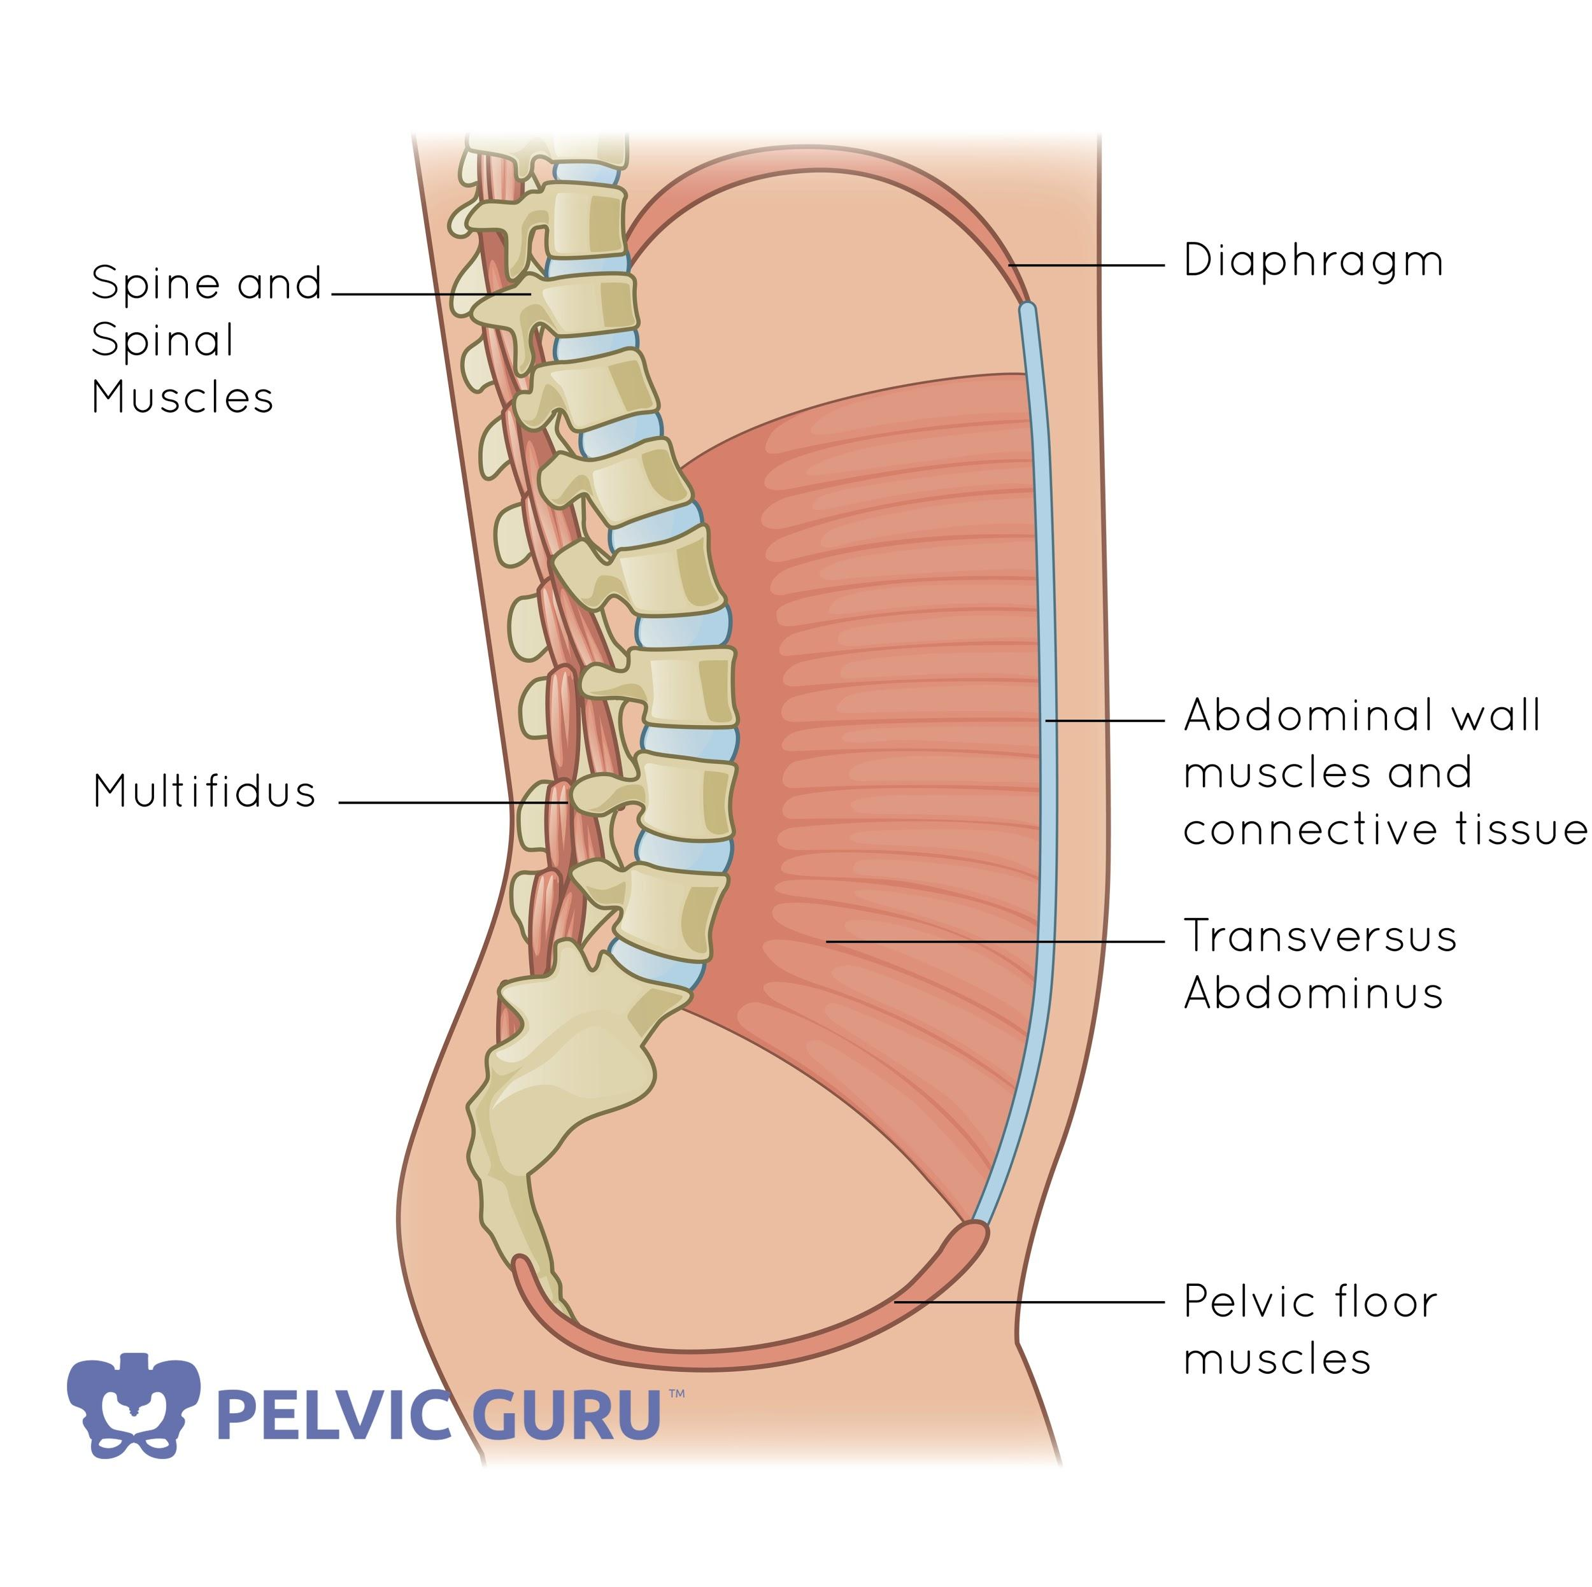
Connection Between the Diaphragm and Pelvic Floor
This often comes as a shock to many people, but your breath influences your pelvic floor. How can that be?
The diaphragm, a broad, dome-shaped muscle at the base of your ribcage, is your primary muscle used in breathing. An intimate relationship exists between the diaphragm and the pelvic floor- they are each a component of the core. The core is the term commonly used to describe the group of musculature that forms a cylindrical pressure system that provides our trunk with stability.
The core consists of:
The diaphragm and vocal cords at the top of the cylinder.
The pelvic floor muscles at the bottom of the cylinder.
The transverse abdominus and multifidi as the support walls of the cylinder.
Permission to use copyright image from Pelvic Guru, LLC
© Body Harmony Physical Therapy, PLLC (2021) - All Rights Reserved
12

Slide 14
Connection Between the Diaphragm and Pelvic Floor
As integral parts of the core, the diaphragm and pelvic floor work together in coordination to provide stability and regulate the pressure inside of our trunk. To do this, the pelvic floor follows the movement of your diaphragm in a piston-like motion. But why?
As you breathe in (inhale), your diaphragm lowers and flattens out allowing air to fill in your lungs. This expansion of your chest cavity presses down on the contents of your abdominopelvic cavity, containing the stomach, liver, pancreas, spleen, gallbladder, kidneys, small and large intestines, urinary bladder and internal reproductive organs. These organs are supported inferiorly by the muscles of your pelvic floor. When the abdominopelvic contents are pushed slightly inferior as your chest expands, your pelvic floor also moves slightly down- imagine stepping your foot down onto a trampoline- lengthening and relaxing your pelvic floor muscles.
When you breathe out (exhale), your diaphragm rises as the air leaves your lungs. Your abdominal contents rise and your pelvic floor also ascends, facilitating muscle shortening and contraction of the pelvic floor.
Thus, we can use our breath to influence what is happening at our pelvic floor. Typically with pelvic pain, we want to help our pelvic floor relax and lengthen. To help us do that, we can practice deep breathing (see exercise on page 9) and pair it with our motor control and coordination exercises of the pelvic floor (see exercises on page 15). Practice trying to lengthen and relax your pelvic floor each time you inhale.
Take Home Message:
As you breathe in, your diaphragm and pelvic floor muscles lower. Thus, inhaling helps us to lengthen and relax the pelvic floor.
As you breathe out, your diaphragm and pelvic floor muscles rise. Thus, exhaling helps us to activate and contract the pelvic floor.
© Body Harmony Physical Therapy, PLLC (2021) - All Rights Reserved
13

Slide 15
CHAPTER 04
Exercises for Pelvic Pain
© Body Harmony Physical Therapy, PLLC (2021) - All Rights Reserved
14

Slide 16
Exercises
Awareness Exercises
Using a cue or timer to check in with your pelvic floor? Are you tensing your muscles? Try to let them relax. Imagining as if you are trying to bulge your pelvic floor down as if you were going to pass gas or have a bowel movement. You can think of this pelvic floor motion like the bottom of a balloon filling with air.
Eventually, you will cultivate more body awareness and begin to notice times where you are holding or clenching your muscles. Any time that you notice that you are tensing your muscles, let them go.
Relaxation Training
Remember the relaxation techniques from Chapter One? Yep, they should be a core part of your regular exercise routine for pelvic pain management!
Coordination and Motor Control
Increases balance, mobility and coordination of pelvis and surrounding musculature
Pelvic Floor Drops
Sit on a rolled up towel or on a physioball. Try to relax and gently lengthen your pelvic floor feeling it sinking down into the towel or ball. Pair pelvic floor drops with the breathing techniques from page 9.
Pelvic clocks
Lay on your back. Imagine that you have a
clock laying on your lower abdomen. Up
towards your belly button is 12 o’clock and
down towards your pubic bone is 6 o’clock. In
a slow and controlled manner, roll your pelvis
up towards 12 o’clock as you exhale. Roll your
pelvis down towards 6 o’clock as you exhale.
It is a small motion. Try not to arch your back
or use your buttocks or legs to move.
© Body Harmony Physical Therapy, PLLC (2021) - All Rights Reserved
15

Slide 17
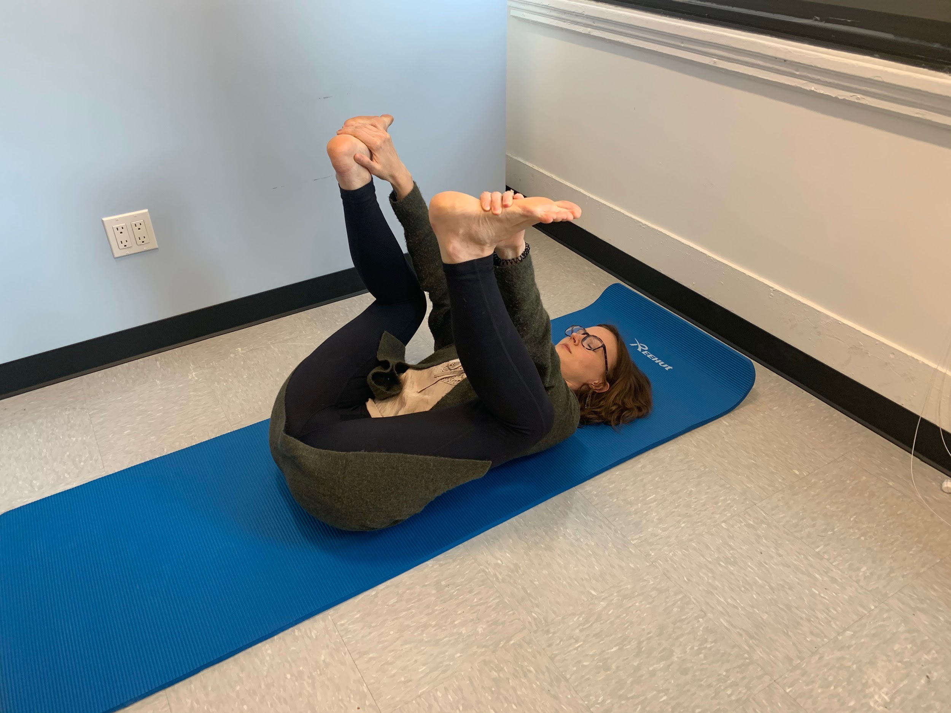
Exercises
Happy Baby Stretch
Happy baby is a calming stretch that helps to
open and release the pelvic floor and hips,
and also stretches the lower back.
Lying flat on your back, slowly bend
both knees until you can hold the
outside edges of your flexed feet with
your hands. (If this position is too
difficult, you can grab your ankles/
lower legs.) Keep your arms on the
outside of your legs.
Be sure to tuck your chin to keep your spine straight
Using your arms, gently pull both knee towards the floor. Be sure to keep your shoulders and chest relaxed.
Standing Active Adductor Stretch
This stretch for the inner thigh is important for people with pelvic pain as these muscles and the connective tissues that attach to them can often become tight and inflexible.
Start by standing with your feet further than hip distance apart. ***Keep in mind, the further you spread your feet, the more intense the stretch so be careful!
Now start to slowly bend at one knee and shift your weight to that leg. You should feel a stretch in your inner thigh.
Be sure to keep your spine straight.
© Body Harmony Physical Therapy, PLLC (2021) - All Rights Reserved
16

Slide 18
Exercises
Active Child’s Pose
Child’s pose allows us to expand the back of our ribcage to breathe more fully and lengthens the soft tissues around the abdomen, allowing us to let go of tension and muscle holding patterns. Adding an active component helps to stretch and lengthen the muscles of our pelvic floor.
Start on all fours with toes flexed with a yoga block in front of you.
Then slowly start to bring your hands to the front of you mat and lower your forehead onto the block. Be sure to keep your spine straight.
Depending on your flexibility you may have to change the orientation of the block so you can fully rest your head and be supported.
Imagine your spine growing longer by pressing down though your hand, reaching forward and reaching back through your heels.
Hold this stretch for 1 minute.
© Body Harmony Physical Therapy, PLLC (2021 - All Rights Reserved)
17

Slide 19
CHAPTER 05
Positions to Ease Pelvic Pain
© Body Harmony Physical Therapy, PLLC (2021) - All Rights Reserved
18

Slide 20
Every Body is Different: Find What Works for You!
Some positions for sexual intercourse may be more comfortable than others. Explore different options and see what works best for you. Here are a few positions to consider and try out:
Missionary Position Variation
Play around with different angles of your hips and knees- flexing or extending them more depending on what feels better
Try arranging pillows on the outside of your knees to prop your legs up for increased support
Play around with the position of your partner’s legs (inside yours legs, outside yours legs) considering if it feels more comfortable for your legs to be more opened or closed.
Lying prone on your belly
Changing the angle of penetration may be a helpful option to consider. Laying on your stomach
Supported kneeling position
Woman on top straddle
Play around with the direction you face, try facing toward your partner or facing away from them depending on what feels best
Play around with your partners position laying down or sitting up
Sidelying
Try facing your partner or facing away. Playing around with your leg position, whether it feels more comfortable with legs more open or closed
© Body Harmony Physical Therapy, PLLC (2021 - All Rights Reserved)
5

Slide 21
CHAPTER 06
A Little Help in the Bedroom
© Body Harmony Physical Therapy, PLLC (2021) - All Rights Reserved
20

Slide 22
Helpful Tools
Sometimes we just need a little help to get us started! Fortunately, there are items that can be useful in decreasing painful sex and enhancing the sexual experience.
Lubricants:
Ideal for women who experience vaginal dryness or tearing during sex. This can be very helpful for women who have undergone menopause or a hysterectomy. Using a lubricant in addition to what your vagina has produced will help decrease friction and irritation as this could be one of the possible causes of painful sex.
Sexual buffer:
The Ohnut is a new and wonderful product designed specifically to help individuals who struggle with deep pelvic pain during sex. This nifty little device provides a soft, customizable ring barrier that allows you to control the depth at which your partner can enter without sacrificing their pleasure in the process. It allows couples to experience sex in a comfortable, pain-free range and so you can relax and feel confident in the bedroom.
Dilators / Toys for Pleasure: Foreplay can be an important missing component in those experiencing painful or uncomfortable sex.
This will get you in the mood to groove, improve your vaginal lubrication, bring blood flow to the pelvic floor musculature allowing greater mobility, and less room for pain.
Communication:
You have to communicate your needs to your partner. Where does it feel good, what position, depth, speed - what do you need in order to be pain-free? Let your partner know.
© Body Harmony Physical Therapy, PLLC (2021) - All Rights Reserved
5

Slide 23
CHAPTER 07
The Role of Nutrition
© Body Harmony Physical Therapy, PLLC (2021) - All Rights Reserved
22

Slide 24
Food is Medicine
What you eat greatly impacts the way your body works, moves, and feels. Your body can’t run by itself. It uses the nutrition you ingest to function. The more efficient or healthy the food you consume the better functioning your body will be. “You are what you eat” just about sums it up. Your diet can fuel your body and make you more healthy, or it can make you feel more sluggish and lead to health common health ailments such as heart disease, diabetes, gastrointestinal distress, or chronic inflammation.
Healthy bowel/bladder support
Our diet affects all aspects of our body, including our gut and bladder. For optimal bowel and bladder health, eat foods that are nutritionally rich, ideally organic fruits and vegetables, organically grown whole grains, hormone free organic meats, and/or wild caught fish. Avoid processed foods that are generally higher in oils, salts, sugars, and fats. Also avoid premade frozen meals where possible. Research and check labels for unhealthy chemicals and additives.
Ideally limit your sugar intake. Again check food labels. Avoid food with added sugar, sweeteners, honey, agave, molasses, syrup or juice. You would be surprised just how much is added to everyday foods. Too much sugar in the diet adversely affects both bowel and bladder function as well as sleep function, headaches and weight gain.
Have bowel trouble and need a little extra goodness for your gut? Bone broth can be taken daily to support bowel health. Bone broth contains glutamine which encourages gut epithelial cell growth!
Sometimes an elimination diet is necessary. It sounds like a drastic step to take but it’s worth the effort. Elimination diets allow you to see first hand the effects food have on your system. Many are often surprised of what their food triggers are. For more information and assistance, we recommend consulting with a nutritionist.
© Body Harmony Physical Therapy, PLLC (2021) - All Rights Reserved
5

Slide 25
Nutrition for Bowel and Bladder Health
Avoiding bladder irritation
Some beverages and foods may cause irritation to the bladder worsening symptoms. This includes coffee, tea, alcohol and carbonated drinks. Citrus fruits like orange, grapefruit, lemon and lime can also irritate the bladder. Tomato based products, spicy food and chocolate are also on that list.
Try eliminating these know irritants out of your diet for one week. Reintroduce one item at a time over a 1-2 day period. If you have increases in bladder symptoms: urinary urgency, frequency or urinary incontinence, then you’ve found a trigger. Sometimes reducing the volume versus eliminating it altogether is sufficient to keep your symptoms at bay.
Hydration
Water! It’s what the majority of your body is made up of: an average of 60% is water ¹. We use water to not only hydrate but flush out toxins that build up in the body. It’s the main thing that keeps your large intestine (colon) happy. The traditional 8 cups of 8 ounces of water per day is gone. Not everyone needs 8 cups of water. It’s now recommended that you drink half your body weight in ounces of water. More water is suggested during pregnancy or with exercise or breastfeeding.
Avoiding constipation
First and foremost, stay hydrated! Your colon needs water to stay healthy and regular. Fiber rich foods including fruits, vegetables and whole grains help to improve digestion. Apples, pears and watermelon may cause gas and affect people who are more gut sensitive. Get moving. Exercising regularly will help to keep your bowel movements regular. Avoid colon sensitive foods and drinks such as coffee.
Pay attention to your urge to go. Don’t delay. The same is said for straining and pushing to start or finish bowel movements. It does more harm than good. Issues like hemorrhoids, anal fissures and rectal prolapses are real and common with this habit. Other signs of constipation include a feeling of incomplete emptying, fewer than 3 bowel movements a week and stool consistency that resembles rocks/pebbles.
© Body Harmony Physical Therapy, PLLC (2021) - All Rights Reserved
5

Slide 26
Diet and Inflammation
Anti-inflammatory diet
Did you know that many disease processes are the result of chronic inflammation in the body? Following a diet that eliminates inflammatory foods, thereby reducing inflammation throughout the body is a good first step to take when looking to treat pelvic pain.
Common anti-inflammatory foods include: flaxseeds (ideally ground), walnuts, salmon, sardines, halibut, herring, soybeans, cauliflower, broccoli, Brussel sprouts, winter squash, tofu, shrimp, cod, snapper, scallops, and tuna. Many of these foods contain high levels of Omega 3s, an anti-inflammatory fatty acid, which is essential to the diet. Omega 3 has been shown to lower cholesterol and decrease hardening of the arteries. You can get Omega 3’s from fish oils but double check the source and purity of the oils before you take them. The National Institute of Health recommends 4,000 mg of Omega 3 per day for your heart. Don’t forget to spice things up in the kitchen! Spices and herbs such as tumeric, garlic, ginger, oregano, cloves, dill, sweet basil, parsley, lime zest and cinnamon add delicious flavor and natural anti-inflammatory benefits to each meal.
Other anti-inflammatory nutrients in the kitchen include antioxidants. Antioxidants can also be beneficial to the body and reduce stressed and damaged cells. It’s likely you will need some professional advice from a nutritionist to get your nutrient imbalances corrected. This includes nutrients like Vitamins A, C, D, E, B6, magnesium, calcium, zinc, iron, potassium, phosphate, selenium and/or copper. For the majority of us it’s better to get an expert on board than stress about how much of each your deficient in and which foods are best to help you re-establish a balance.
© Body Harmony Physical Therapy, PLLC (2021) - All Rights Reserved
5

Slide 27
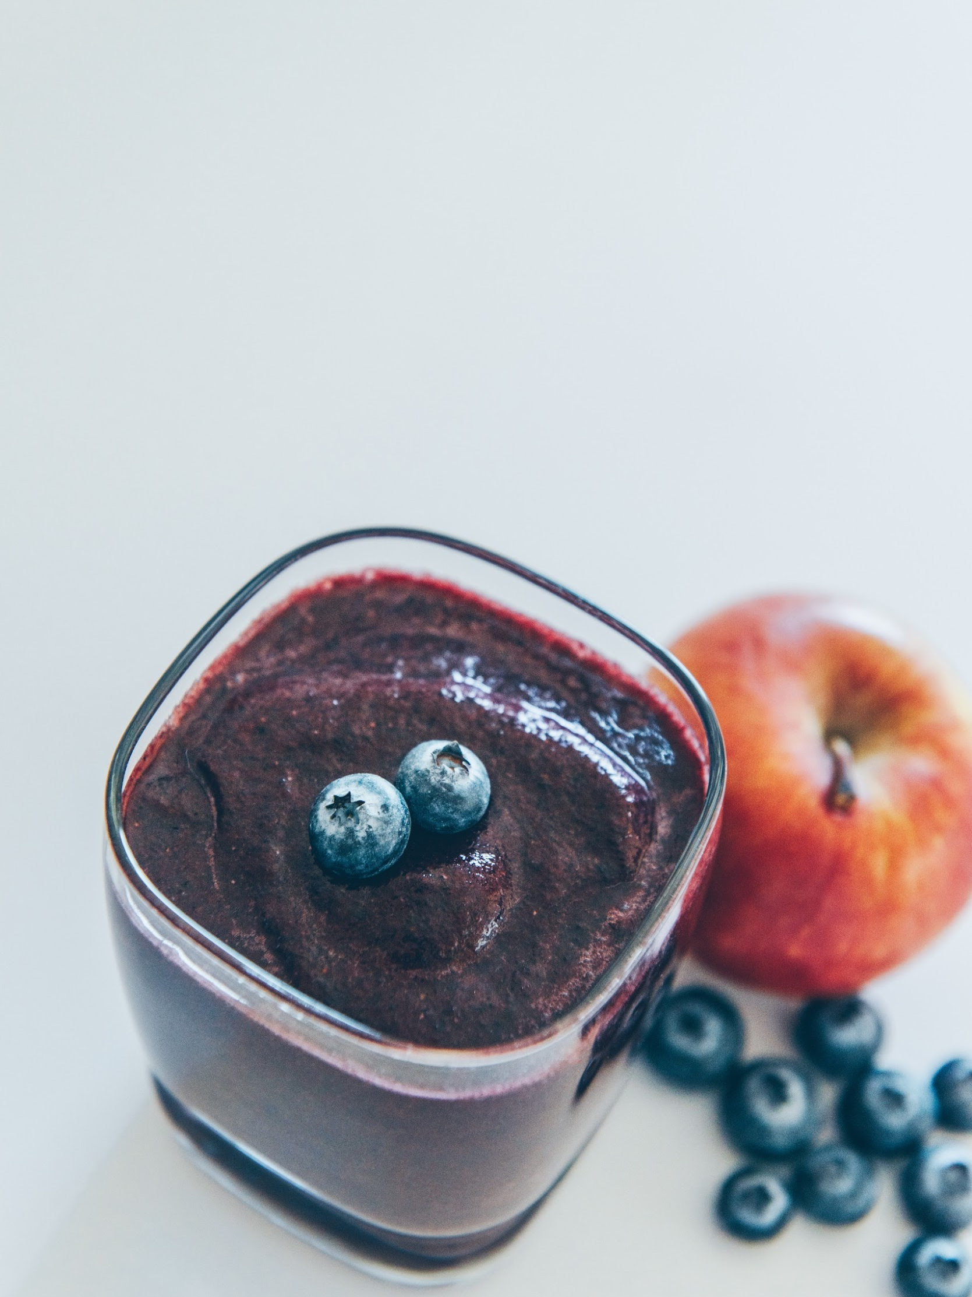
Anti-inflammatory Smoothie
Anti-inflammatory smoothie for pelvic pain relief
Try Jessica Drummond’s antioxidant-rich smoothie from that is bursting with anti-inflammatory benefits to help reduce pelvic pain.
Ingredients:
1/2 avocado
1/2 cup chopped raw kale or a scoop of greens powder
1/2 cup of frozen blueberries
20g high quality protein powder (For this recipe, I recommend Pure Paleo from Designs for Health.)
1/2 tsp cinnamon
1-2 cups unsweetened vanilla almond milk
Blend and enjoy!
Interested in more information on how nutrition can help pelvic pain, optimize women’s health and balance hormones?
Check out Jessica Drummond’s Integrative Women's Health Institute program or follow her on Instagram and Facebook for helpful tips and recipes!
© Body Harmony Physical Therapy, PLLC (2021) - All Rights Reserved
5

Slide 28
CHAPTER 08
Physical Therapy for My What?!
© Body Harmony Physical Therapy, PLLC (2021) - All Rights Reserved
24

Slide 29
Pelvic Floor Physical Therapy
Is it right for me? Some things to consider:
Do you have pelvic pain? Penis or testicular pain? Bladder pain? Rectal pain?
Have you been seen by a physician to rule out infection or other serious pathology?
Have you been treated for prostatitis or other infection, but your pain and symptoms continue to linger?
Do you have pain with intercourse, sitting, urination?
Hip or low back pain
Constipation or feelings of incomplete emptying?
Abdominal, groin, or pelvic pain and scar tissue following hernia repair or other surgery?
Urinary or fecal incontinence after prostate surgery?
Healing trauma after sexual abuse?
These are indicators that your pelvic floor muscles may not be functioning optimally and could benefit from a pelvic PT evaluation.
If you have followed the advice in this e-book and still struggle with painful sex, don’t be discouraged. Pelvic pain is a complex issue, but a skilled pelvic health physical therapist can help!
What is Pelvic PT
Pelvic Health Physical Therapy is a specialized field of orthopedic physical therapy dedicated to treating pelvic pain and dysfunction. Pelvic health PTs also also highly skilled at treat hip and back pain, which may often be related to pelvic floor dysfunction.
How Can it Help?
List some research here maybe- minimal but enough for buy in.
Call in for a free 15 minute consultation to figure out if pelvic health PT is right for you and discover how our therapists can help you reach your goals!
© Body Harmony Physical Therapy, PLLC (2021) - All Rights Reserved
5

Slide 30
Pelvic Floor Physical Therapy
What to Expect
Pelvic health PT’s are first and foremost physical therapists, meaning that they are experts of the movement system. They will not only evaluate your pelvic floor, but they should also assess your overall musculoskeletal/neuromuscular systems and how your pelvic floor integrates and functions with your whole body.
This evaluation process includes:
A complete health history and review
General musculoskeletal and neurological examination (including pelvic internal and/or external assessment as appropriate and with your consent) and evaluation of fascial and visceral restrictions
Postural evaluation and movement analysis
Patient education about the condition (including anatomy and physiology)
Development of an individualized treatment plan, including home exercise program, that is made with your goals in mind
How about the pelvic assessment?
Pelvic Floor dysfunction may be evaluated, assessed and treated, with informed consent, internally via the vagina and/or rectum.
This requires advanced intensive training by a physical therapist. Internal pelvic floor exams performed by a physical therapist are different than those done by other clinicians. Physical therapists do not use speculums and in general spend more time evaluating the pelvic floor muscles including their tone, strength and ability to relax. Pelvic floor physical therapists are also sensitive to areas of spasm or pain as well as any other issues you may have.
Your therapist should review your condition with you and work with your to determine a plan of care going forward that works for you and will help you meet your goals. Depending on your conditions and severity. Treatment sessions vary from 1-3 times per week. Your individualized session will include physical therapy treatments that are beneficial to your specific condition. You will be taught a home exercise program which will progress over the course of treatment. A therapist will re-evaluate every 5-6 weeks and communicate your progress and treatment with your other health care providers.
© Body Harmony Physical Therapy, PLLC (2021) - All Rights Reserved
5
Notes:
The therapists at Body Harmony Physical Therapy evaluate, assess, and treat a variety of musculoskeletal, neurological, geriatric, women’s health, and pelvic floor (men and women) conditions. We welcome you to bring a spouse, trusted friend, or therapist with you to any of your sessions.
Treatment Sessions – 2-3 times per week: The therapist will review your condition with you and address any questions you have. Your individualized session will include physical therapy treatments that are beneficial to your specific condition. You will be taught a home exercise program which will progress over the course of treatment. The therapist will re-evaluate every 5-6 weeks and communicate your progress and treatment with your other health care providers. A session may include:
Pelvic Floor dysfunction may be evaluated, assessed and treated, with informed consent, internally via the vagina and/or rectum. The Section on Women’s Health of the American Physical Therapy Association recommends that
Any internal pelvic (vaginal or rectal) myofascial release or soft tissue mobilization techniques that would require a continuous ongoing re-evaluation and reassessment should be performed by the physical therapist.
This requires advanced intensive training by a physical therapist. Internal pelvic floor exams performed by a physical therapist are different than those done by other clinicians. Physical therapists do not use speculums and in general spend more time evaluating the pelvic floor muscles including their tone, strength and ability to relax. Pelvic floor physical therapists are also sensitive to areas of spasm or pain as well as any other issues you may have.
Patient education for relaxation and stress reduction techniques to break the pain cycle
Manual therapy: Myofascial release, connective tissue manipulation, myofascial trigger point release, joint mobilization
Neuromuscular re-education
Postural re-education (including treatment and self-correction)
Progression of stretches and exercises to enhance core stabilization, function, and activities of daily living
Home exercise program
A typical home exercise program will include
Relaxation and stress reduction techniques
Stretching and exercise protocol
Self myofascial trigger point release
Pain relief modalities or biofeedback when indicated
Resources for your education such as books and CDs
We also offer week-long intensive treatment sessions for out-of-towners. Please call our office to learn more about this program.

Slide 31
Pelvic Floor Physical Therapy
Patient education for relaxation and stress reduction techniques to break the pain cycle
Manual therapy: Myofascial release, connective tissue manipulation, myofascial trigger point release, joint mobilization
Neuromuscular re-education
Postural re-education (including treatment and self-correction)
Progression of stretches and exercises to enhance core stabilization, function, and activities of daily living
Home exercise program
A typical home exercise program will include
Relaxation and stress reduction techniques
Stretching and exercise protocol
Self myofascial trigger point release
Pain relief modalities or biofeedback when indicated
Resources for your education such as books and CDs
Services:
Manual therapy consisting of soft tissue mobilization for muscles, connective tissues, neurovascular tissue, scar tissue mobilizations, & gentle stretching.
Muscle re-education to normalize muscle tone and muscle imbalances, and reduce dysfunctional movement patterns, and postural dysfunction.
Personalized exercise programs including: relaxation techniques, breathwork, motor control and coordination exercises, and strengthening exercises for the core, hip, and pelvic floor muscles.
© Body Harmony Physical Therapy, PLLC (2021) - All Rights Reserved
5
Notes:
The therapists at Body Harmony Physical Therapy evaluate, assess, and treat a variety of musculoskeletal, neurological, geriatric, women’s health, and pelvic floor (men and women) conditions. We welcome you to bring a spouse, trusted friend, or therapist with you to any of your sessions.
Your initial session will include:
A complete health history and review
General musculoskeletal and neurological examination (internal and/or external) and evaluation of fascial and visceral restrictions
Postural evaluation
Patient education about the condition (including anatomy and physiology)
Development of an individualized treatment plan including home exercise program
Treatment Sessions – 2-3 times per week: The therapist will review your condition with you and address any questions you have. Your individualized session will include physical therapy treatments that are beneficial to your specific condition. You will be taught a home exercise program which will progress over the course of treatment. The therapist will re-evaluate every 5-6 weeks and communicate your progress and treatment with your other health care providers. A session may include:
Pelvic Floor dysfunction may be evaluated, assessed and treated, with informed consent, internally via the vagina and/or rectum. The Section on Women’s Health of the American Physical Therapy Association recommends that
Any internal pelvic (vaginal or rectal) myofascial release or soft tissue mobilization techniques that would require a continuous ongoing re-evaluation and reassessment should be performed by the physical therapist.
This requires advanced intensive training by a physical therapist. Internal pelvic floor exams performed by a physical therapist are different than those done by other clinicians. Physical therapists do not use speculums and in general spend more time evaluating the pelvic floor muscles including their tone, strength and ability to relax. Pelvic floor physical therapists are also sensitive to areas of spasm or pain as well as any other issues you may have.
Patient education for relaxation and stress reduction techniques to break the pain cycle
Manual therapy: Myofascial release, connective tissue manipulation, myofascial trigger point release, joint mobilization
Neuromuscular re-education
Postural re-education (including treatment and self-correction)
Progression of stretches and exercises to enhance core stabilization, function, and activities of daily living
Home exercise program
A typical home exercise program will include
Relaxation and stress reduction techniques
Stretching and exercise protocol
Self myofascial trigger point release
Pain relief modalities or biofeedback when indicated
Resources for your education such as books and CDs
We also offer week-long intensive treatment sessions for out-of-towners. Please call our office to learn more about this program.

Slide 32
Consult a Pelvic Health Physical Therapist
Sex should never be painful. You deserve pleasurable sex, free from pain, anxiety, and embarrassment. Body Harmony Physical Therapy is here to help!
To schedule an evaluation or to speak to a pelvic health physical therapist and see if physical therapy is right for you, give us a call. (212) 233-9494
233 Broadway, Suite 2060
New York, NY
10279
9

Slide 33
Resources
Books
Healing Painful Sex
Pelvic Pain Explained
Explain Pain
Healing Pelvic Pain
Apps
Calm
Insight timer
Headspace
Organizations and Associations for Pelvic Pain
International Pelvic Pain Society
American College of Obstetricians and Gynecologists
American Chronic Pain Association
National Vulvodynia Association
American Society for Colposcopy and Cervical Pathology
Endometriosis Association
Interstitial Cystitis Association
International Pelvic Pain Society
International Society for the Study of Vulvovaginal Disease
International Painful Bladder Foundation
International Society for the Study of Women’s Sexual Health
National Association for Continence
National Women’s Health Resource Center
National Pain Foundation
Pudendal Hope
Pudendal Neuralgia Association
Society for Sex Therapy and Research
Society for Women’s Health Research
Vulval Pain Society
© Body Harmony Physical Therapy, PLLC (2021) - All Rights Reserved
27

Slide 34
Looking for a Pelvic Health PT? We got you!
Do you want to schedule a pelvic PT session, but don’t know where to find a pelvic rehab trained therapist? Search for Pelvic Health PT’s near you by checking out these valuable directories and resources to find trusted pelvic rehab practitioners!
Pelvic Guru Directory
https://pelvicguru.com/directory/
Academy of Pelvic Health PT Locator
a pelvic floor physical therapist
Herman and Wallace’s Pelvic Rehab Directory
https://pelvicrehab.com/
© Body Harmony Physical Therapy, PLLC (2021) - All Rights Reserved

Slide 35
References
Coady, D. Fish, N. Healing Painful Sex. New York: Seal Press, 2011.
Herman and Wallace Pelvic Floor Course I:: The Sages College; August 2019; Albany.
Porges, SW. The Polyvagal Theory: Neurophysiological Foundations of Emotions, Attachment, Communication, and Self-Regulation. New York: W.W. Norton, 2011.
Wallace, Kathe. Vulvar Care and Best Hygiene Practices Handout.
Herman and Wallace Orthopedic considerations for Sexual activity Handout
Drummond, Jessica. Integrative Women’s Health Institute Women’s Health Coaching Course.
Some images obtained from Unsplash
© Body Harmony Physical Therapy, PLLC (2021) - All Rights Reserved
28

